Slide 1
Employee Turnover

Slide 2
Use Case:
XYZ Corporation is a sportswear company. They are having difficulty controlling their employee turnover rates. It is important that XYZ understand first, who is likely to be leave the company and why, and second, activities they can engage in to start decreasing the volume of employees that leave. It is estimated that each employee that quits represents a cost of 300% of their annual salary.
They have collected the data on their employees that they have found so far and would like to use this dataset to predict which employees are at risk of leaving and why.

Slide 3
Architecture

Slide 4
Outcomes
--- Explainability: Please prepare to explain local feature effects for every observation of the holdout dataset.
--- Bias: It is of critical importance that this model does not bias against any protected classes. Please ensure that the outcome of this model does not result in any such bias. No bias beyond 5% outcome disparity is acceptable in any protected class.

Slide 5
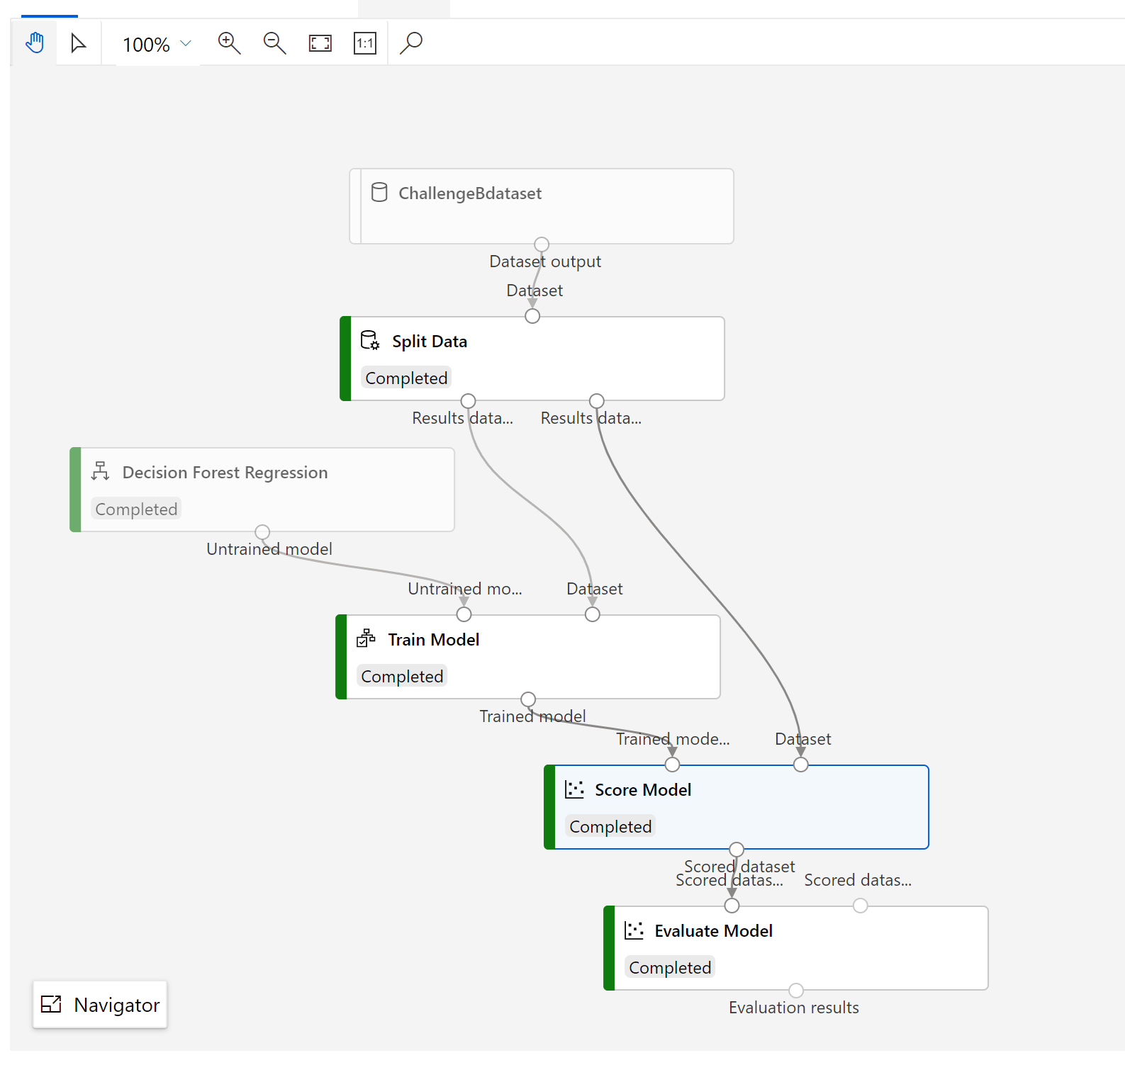

Slide 6
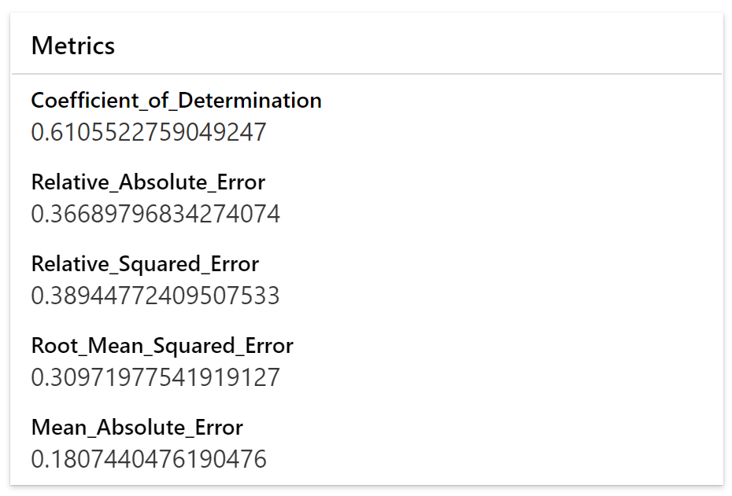
Output Metrics
RMSE – Root Mean Squared Error is pretty log
Predicted value could be in the range of +-0.3

Slide 7
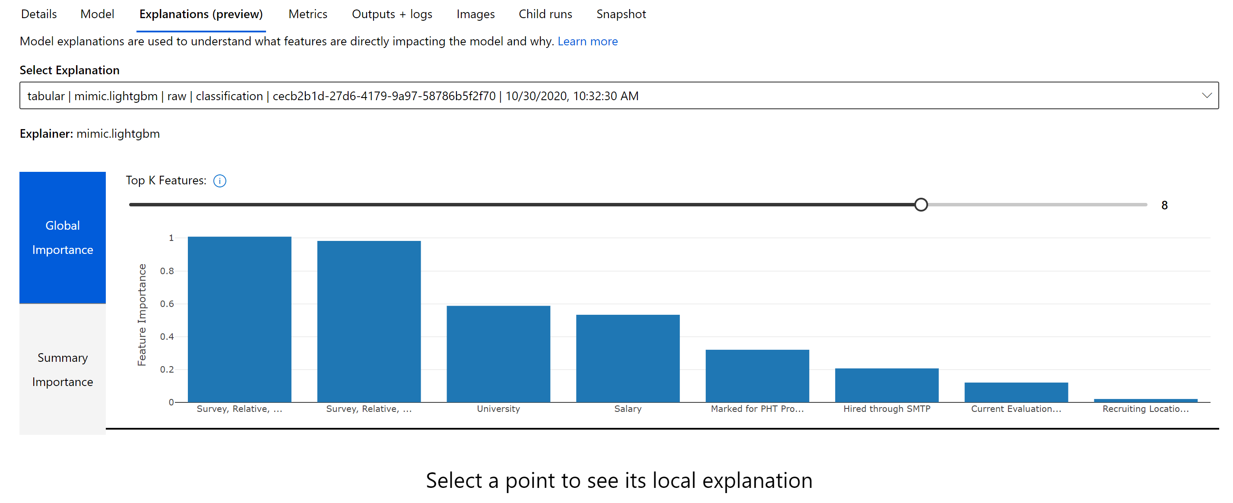
Explain ability – Global Importance

Slide 8
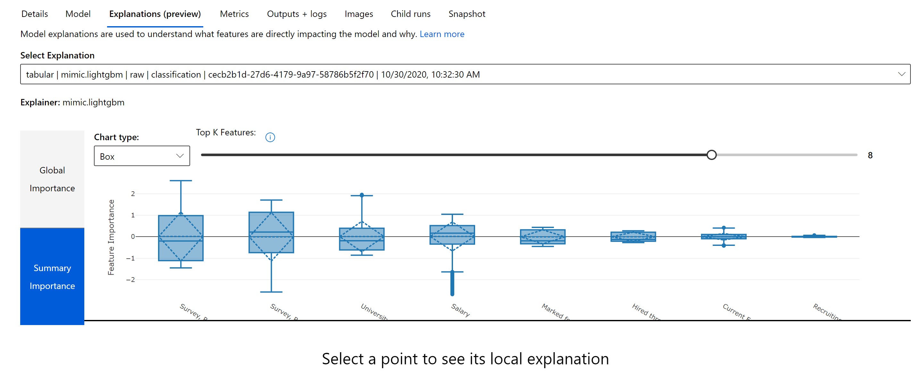
Summary Importance

Slide 9
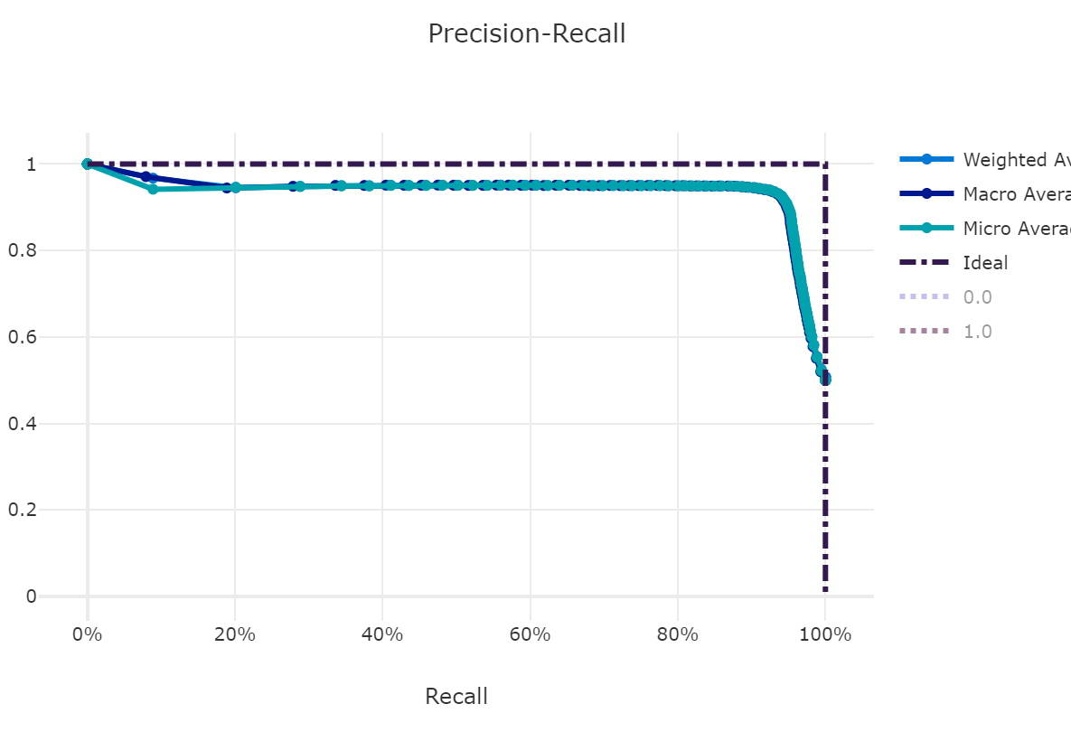
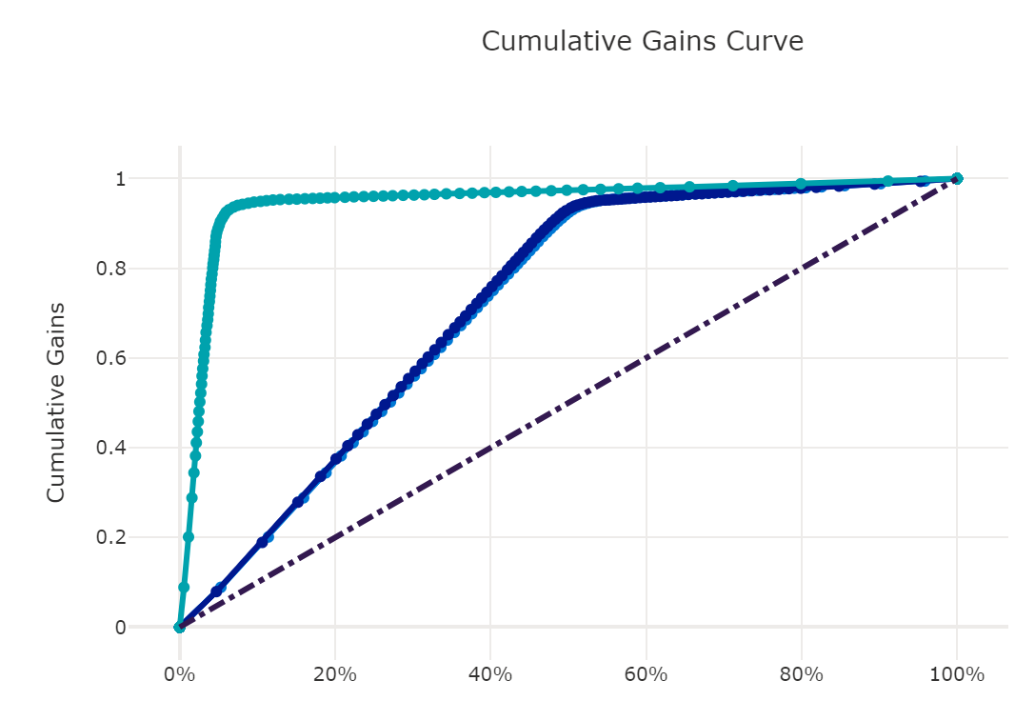
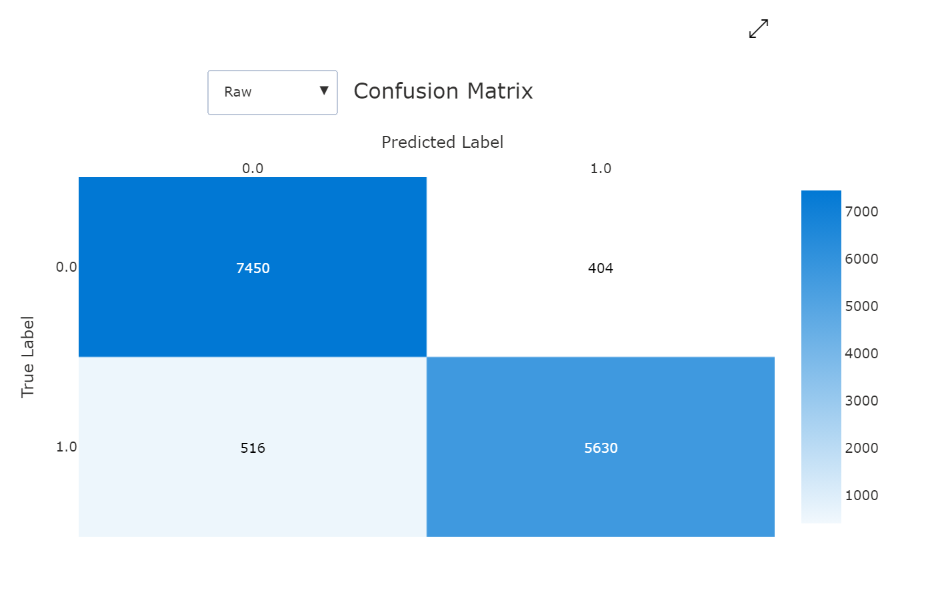
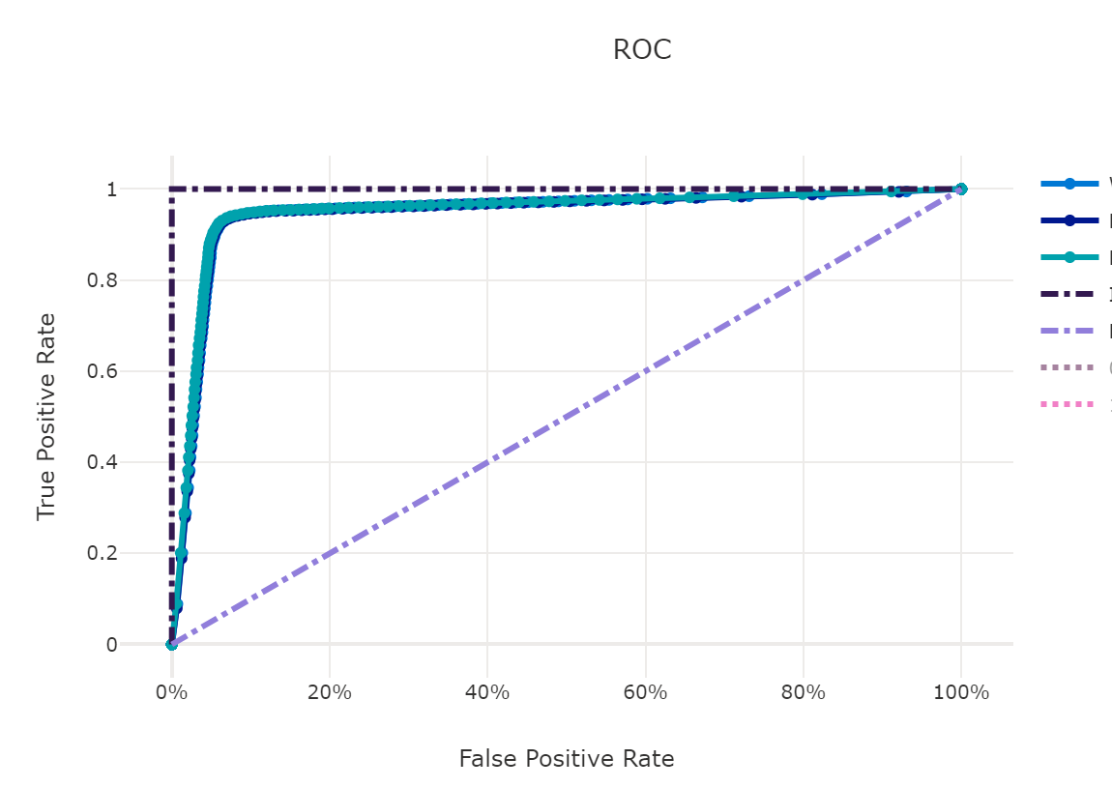
Metrics
Roc Slope is close to better prediction
More closer to 100%, more accurate the model is
Precision Recall are pretty high, shows the model accuracy is pretty Good.

Slide 10
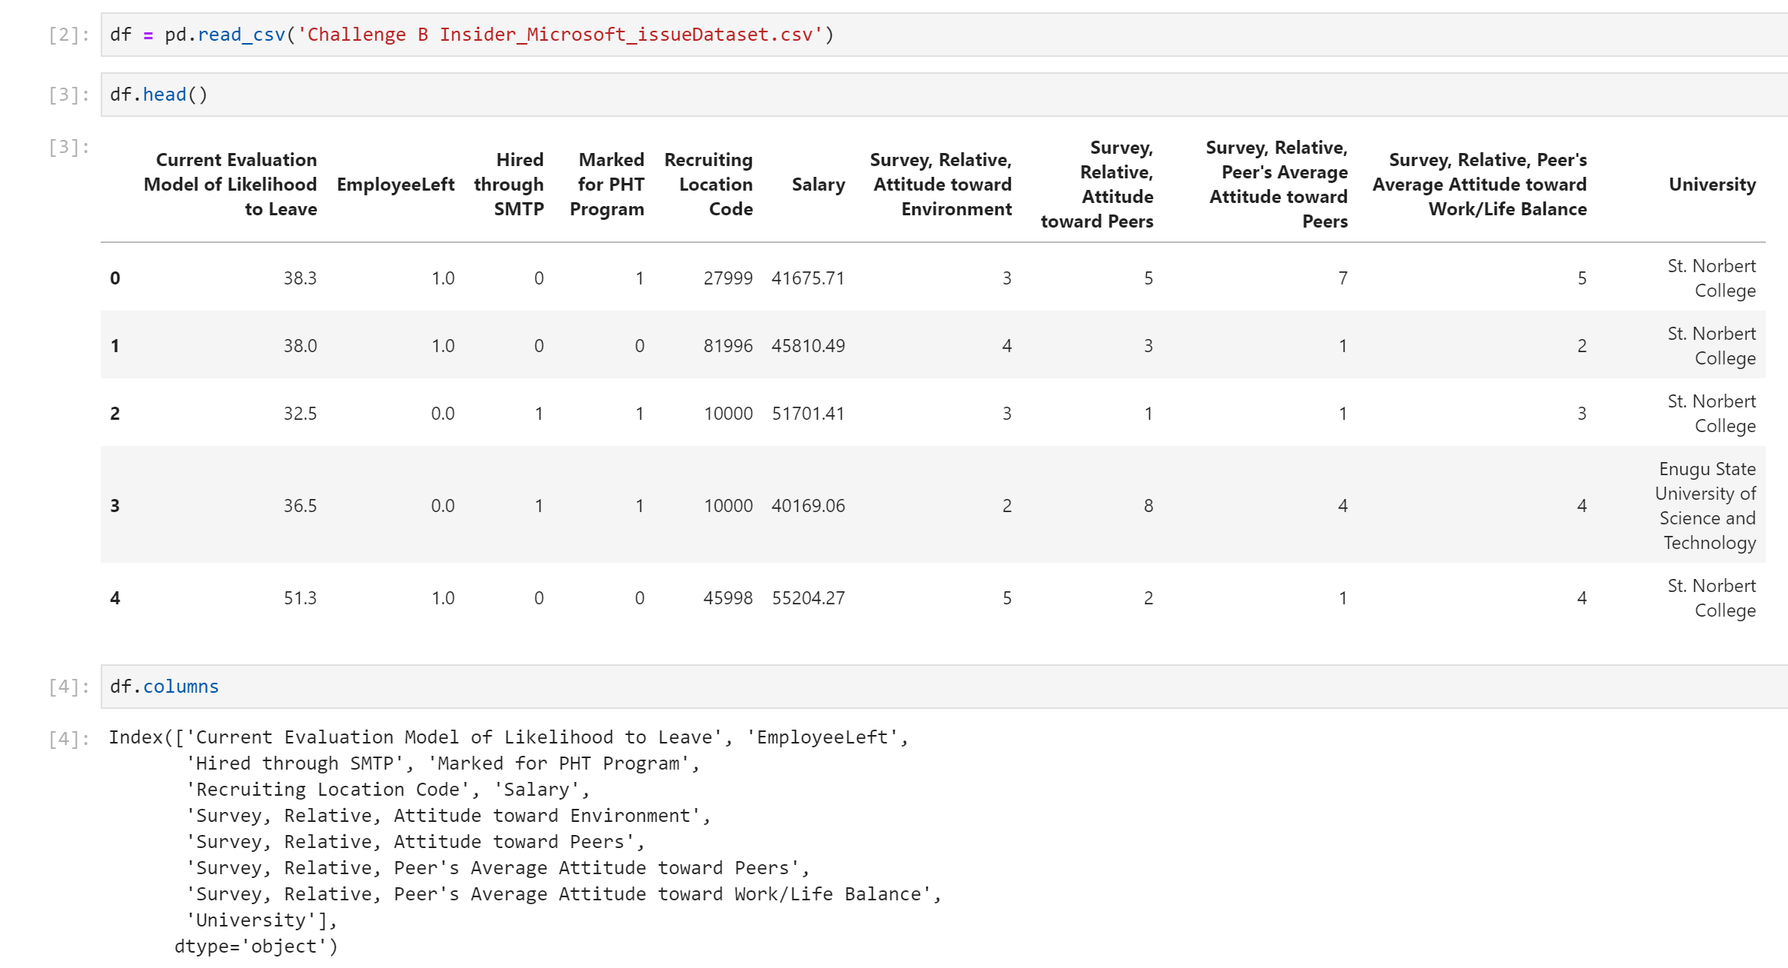

Slide 11
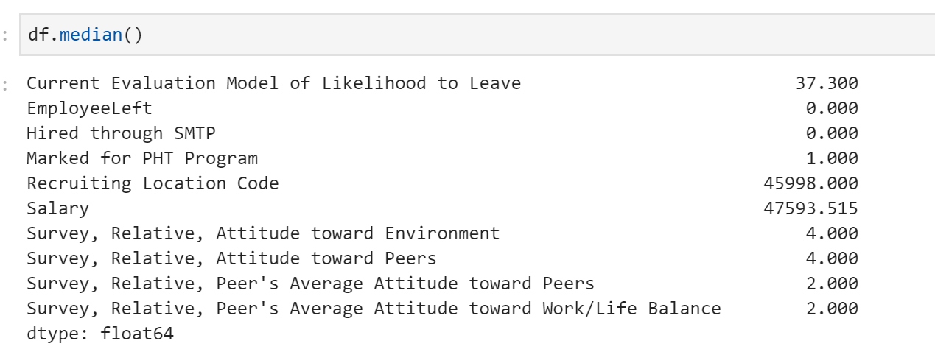
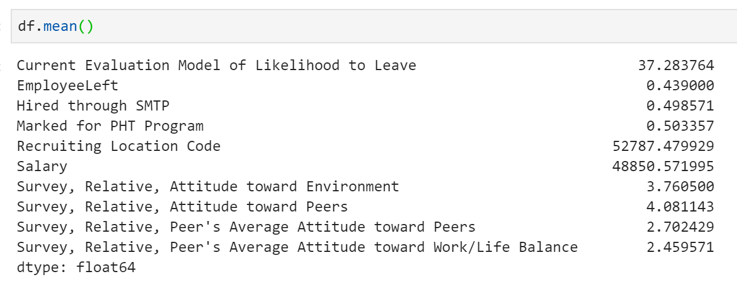
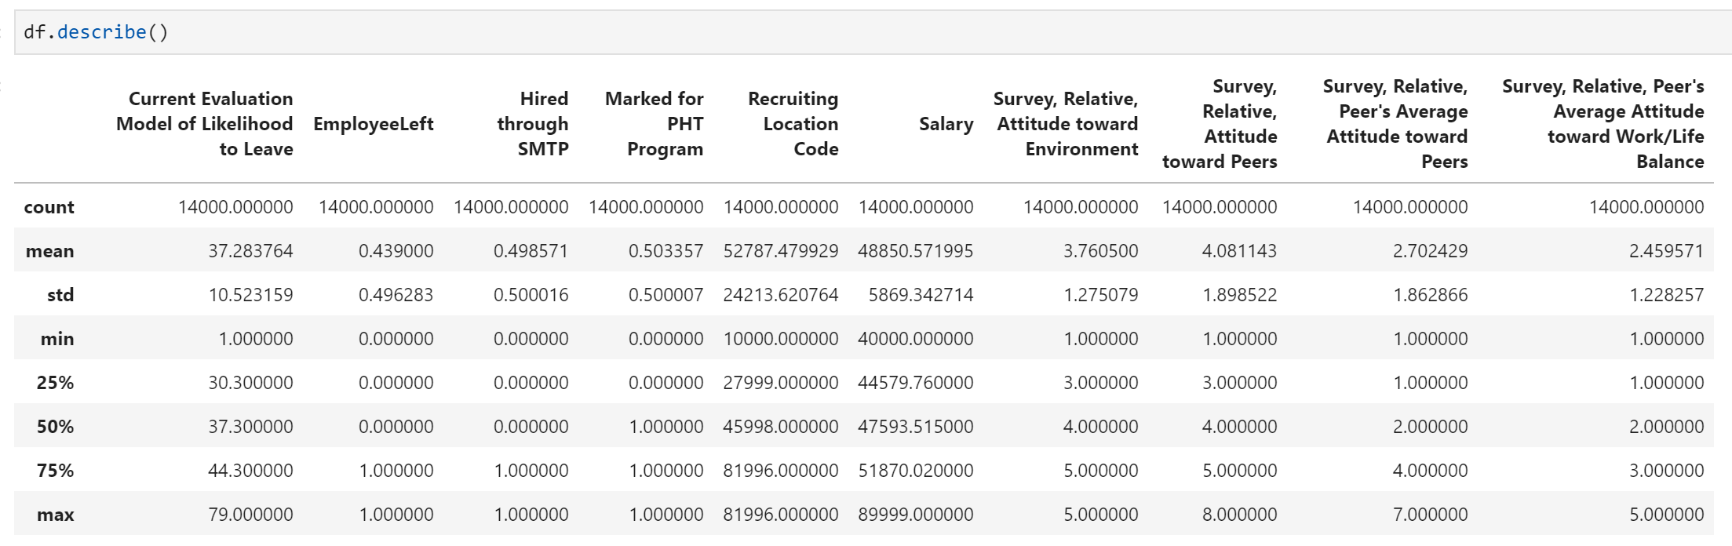

Slide 12
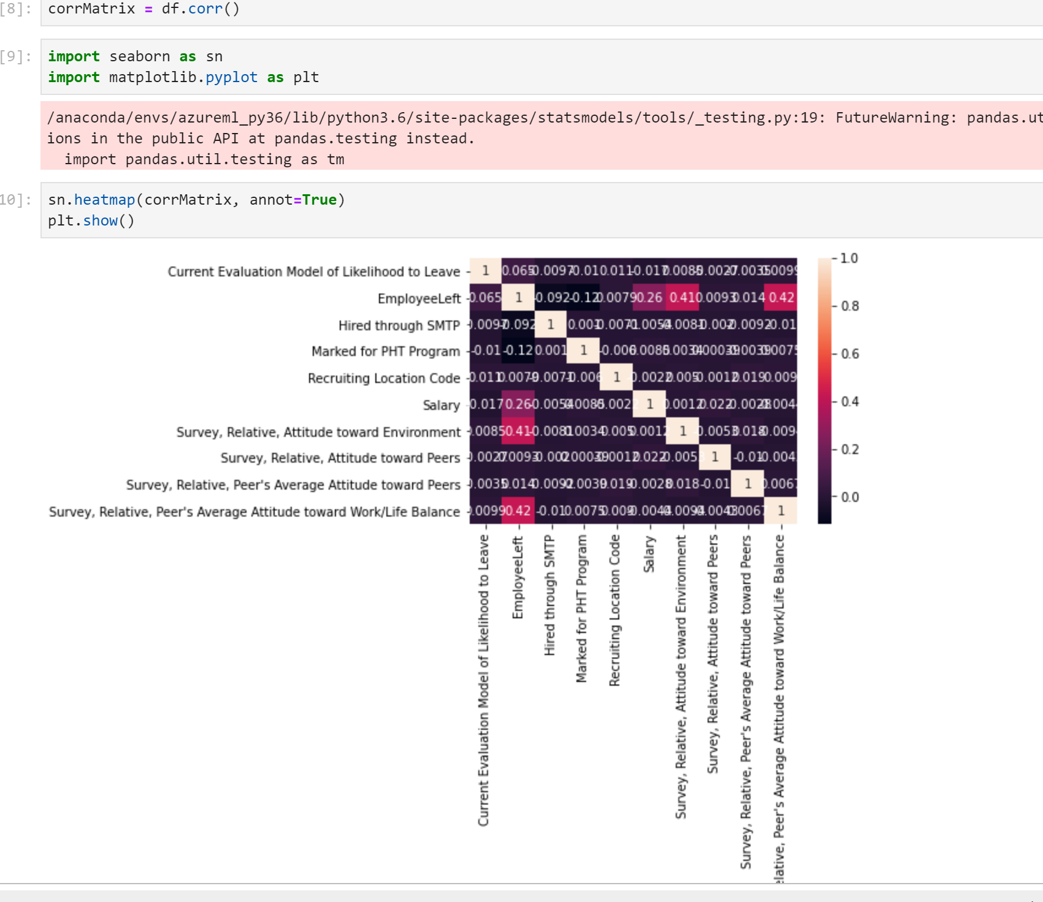
Correlation

Slide 13
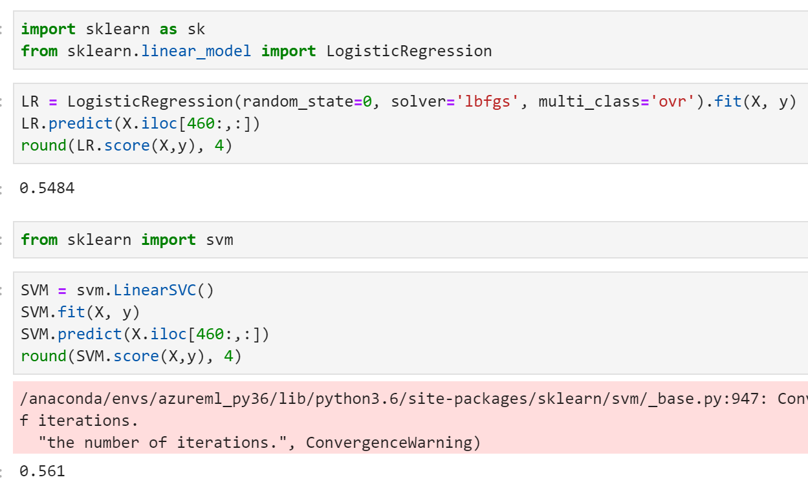
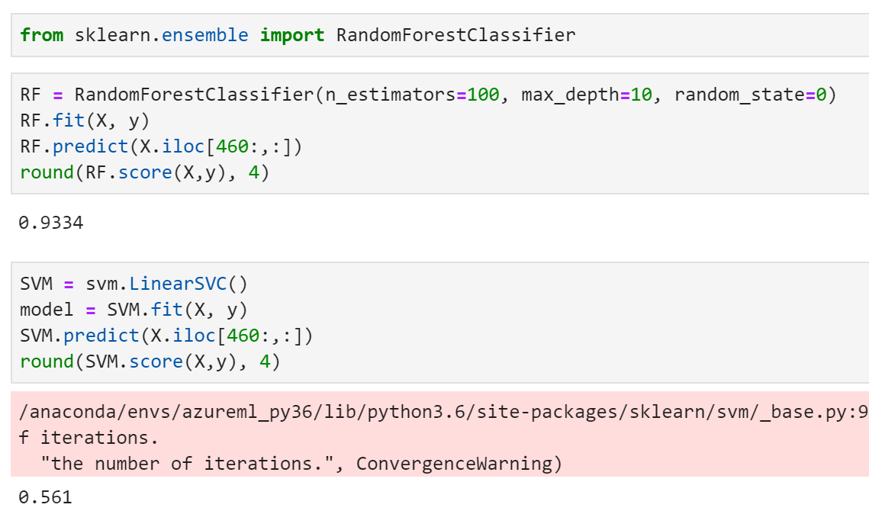
Model and Accuracy

Slide 14
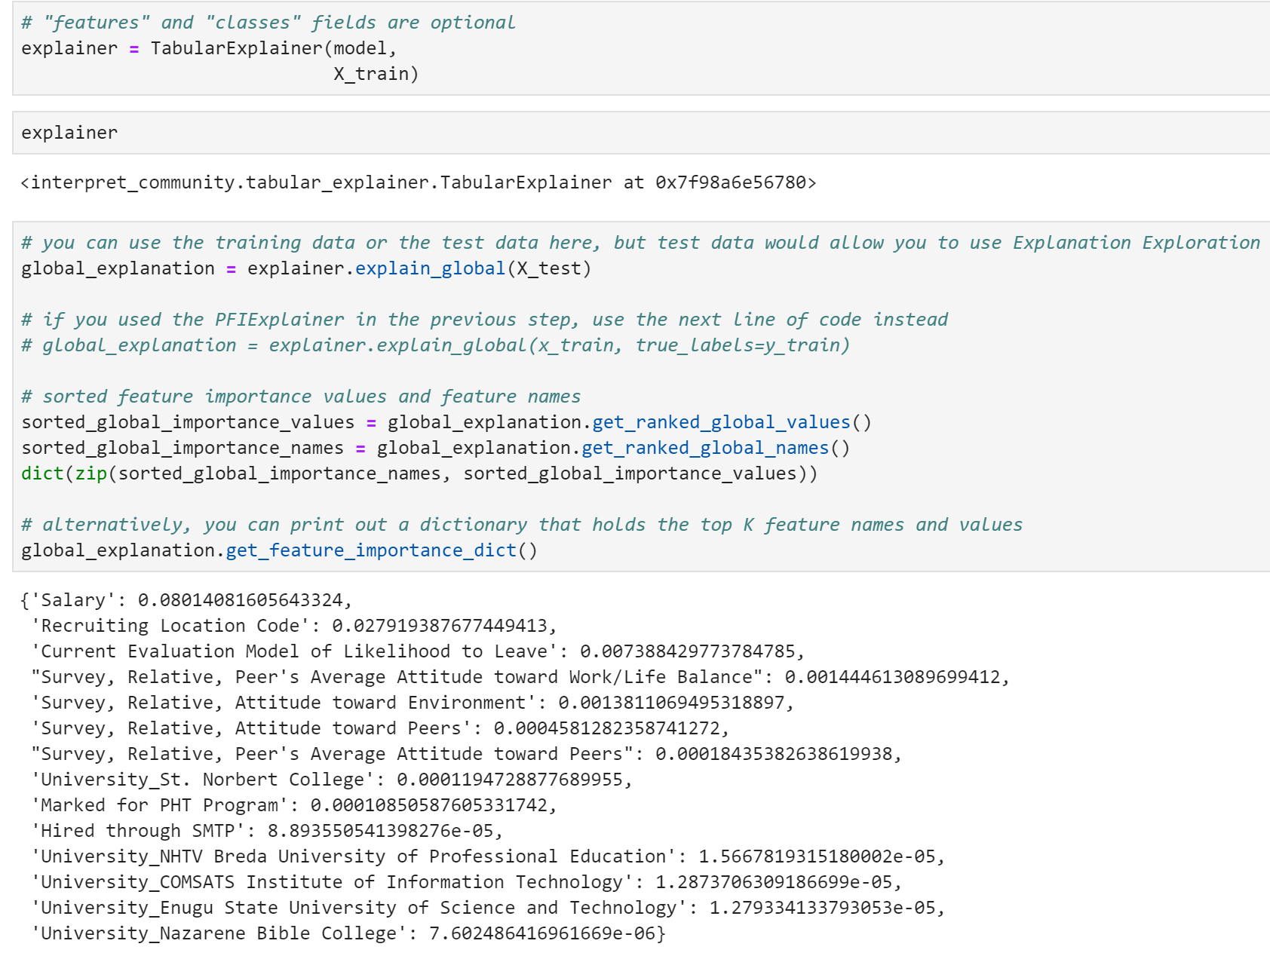
Explainability

Slide 15
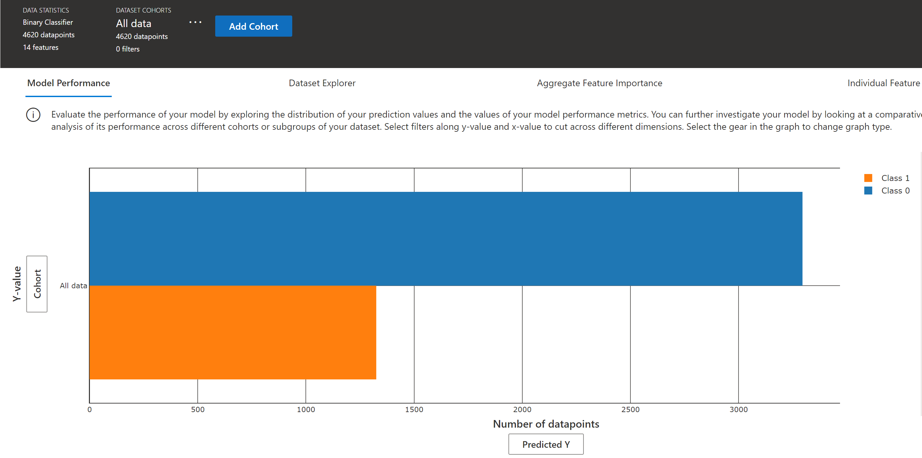
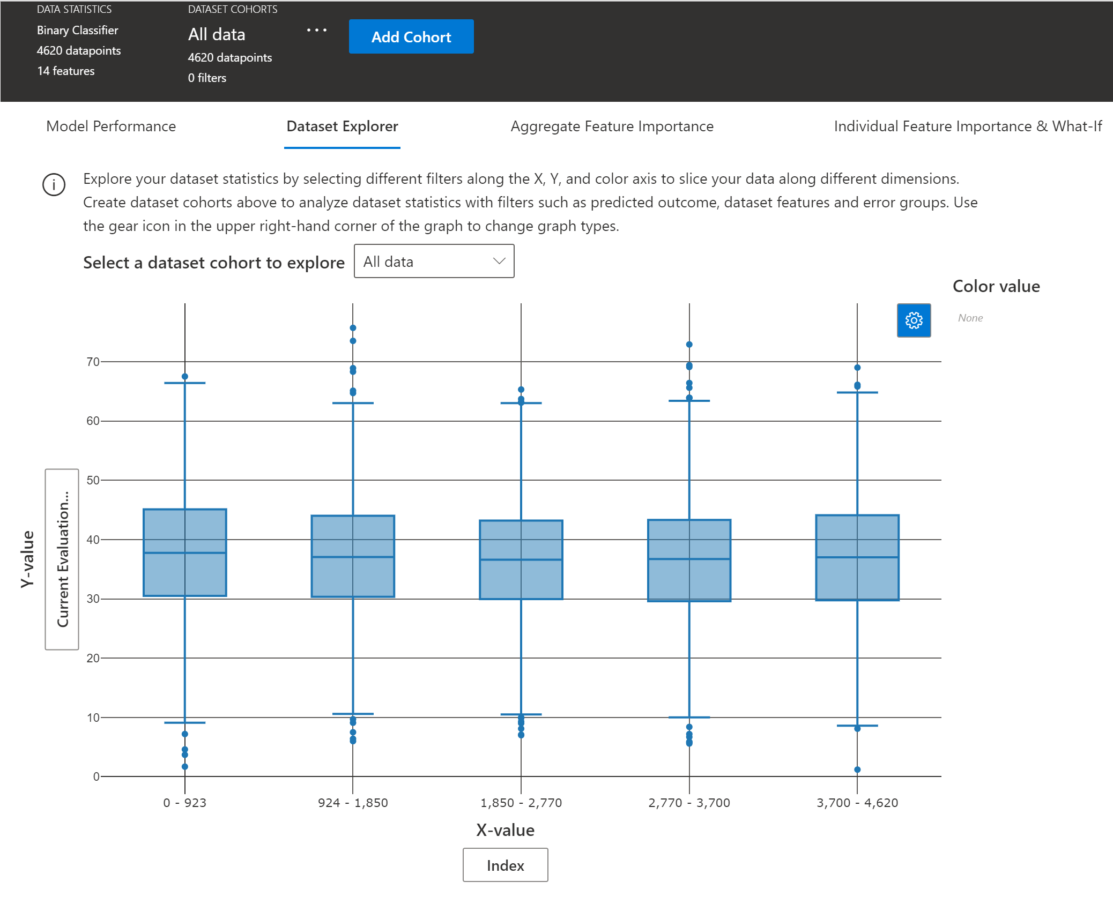
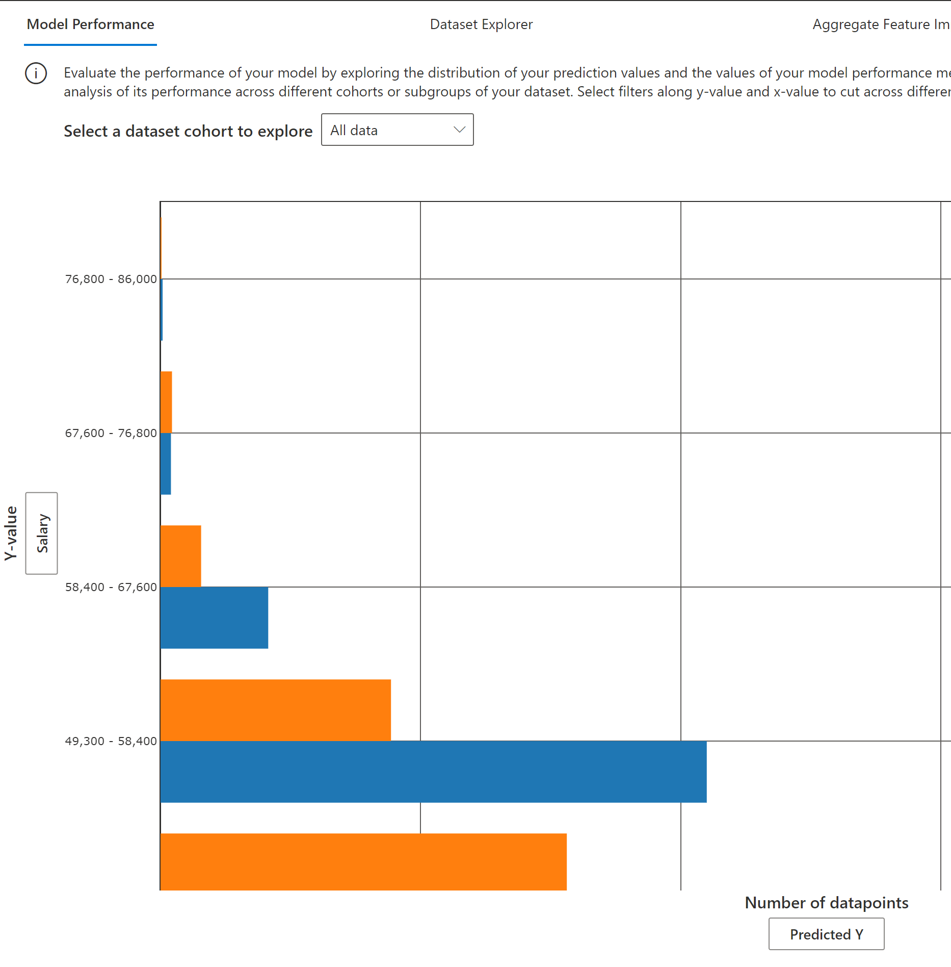
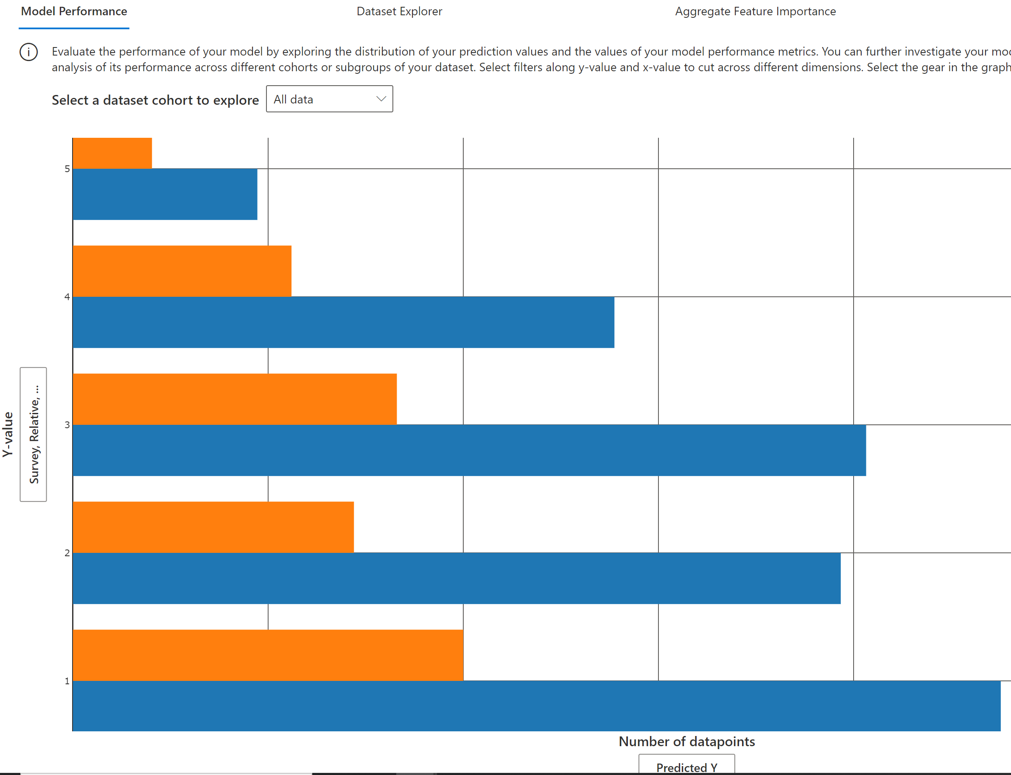
Model Performance

Slide 16
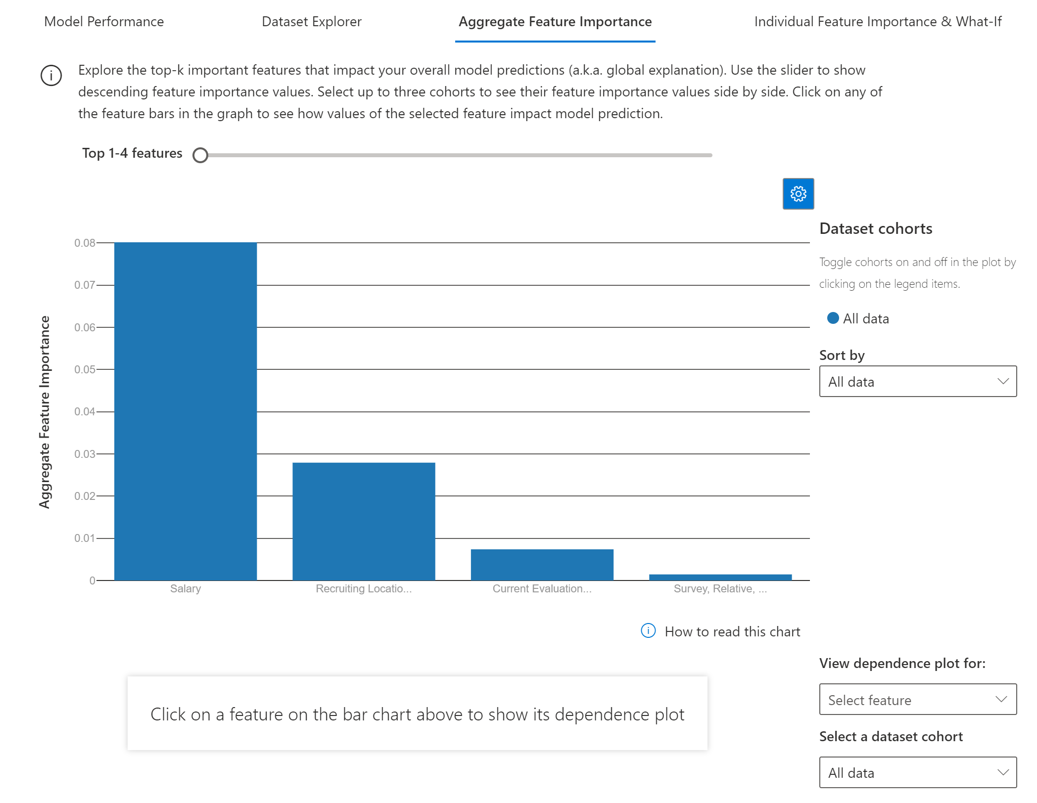
Aggregate Feature Importance

Slide 17
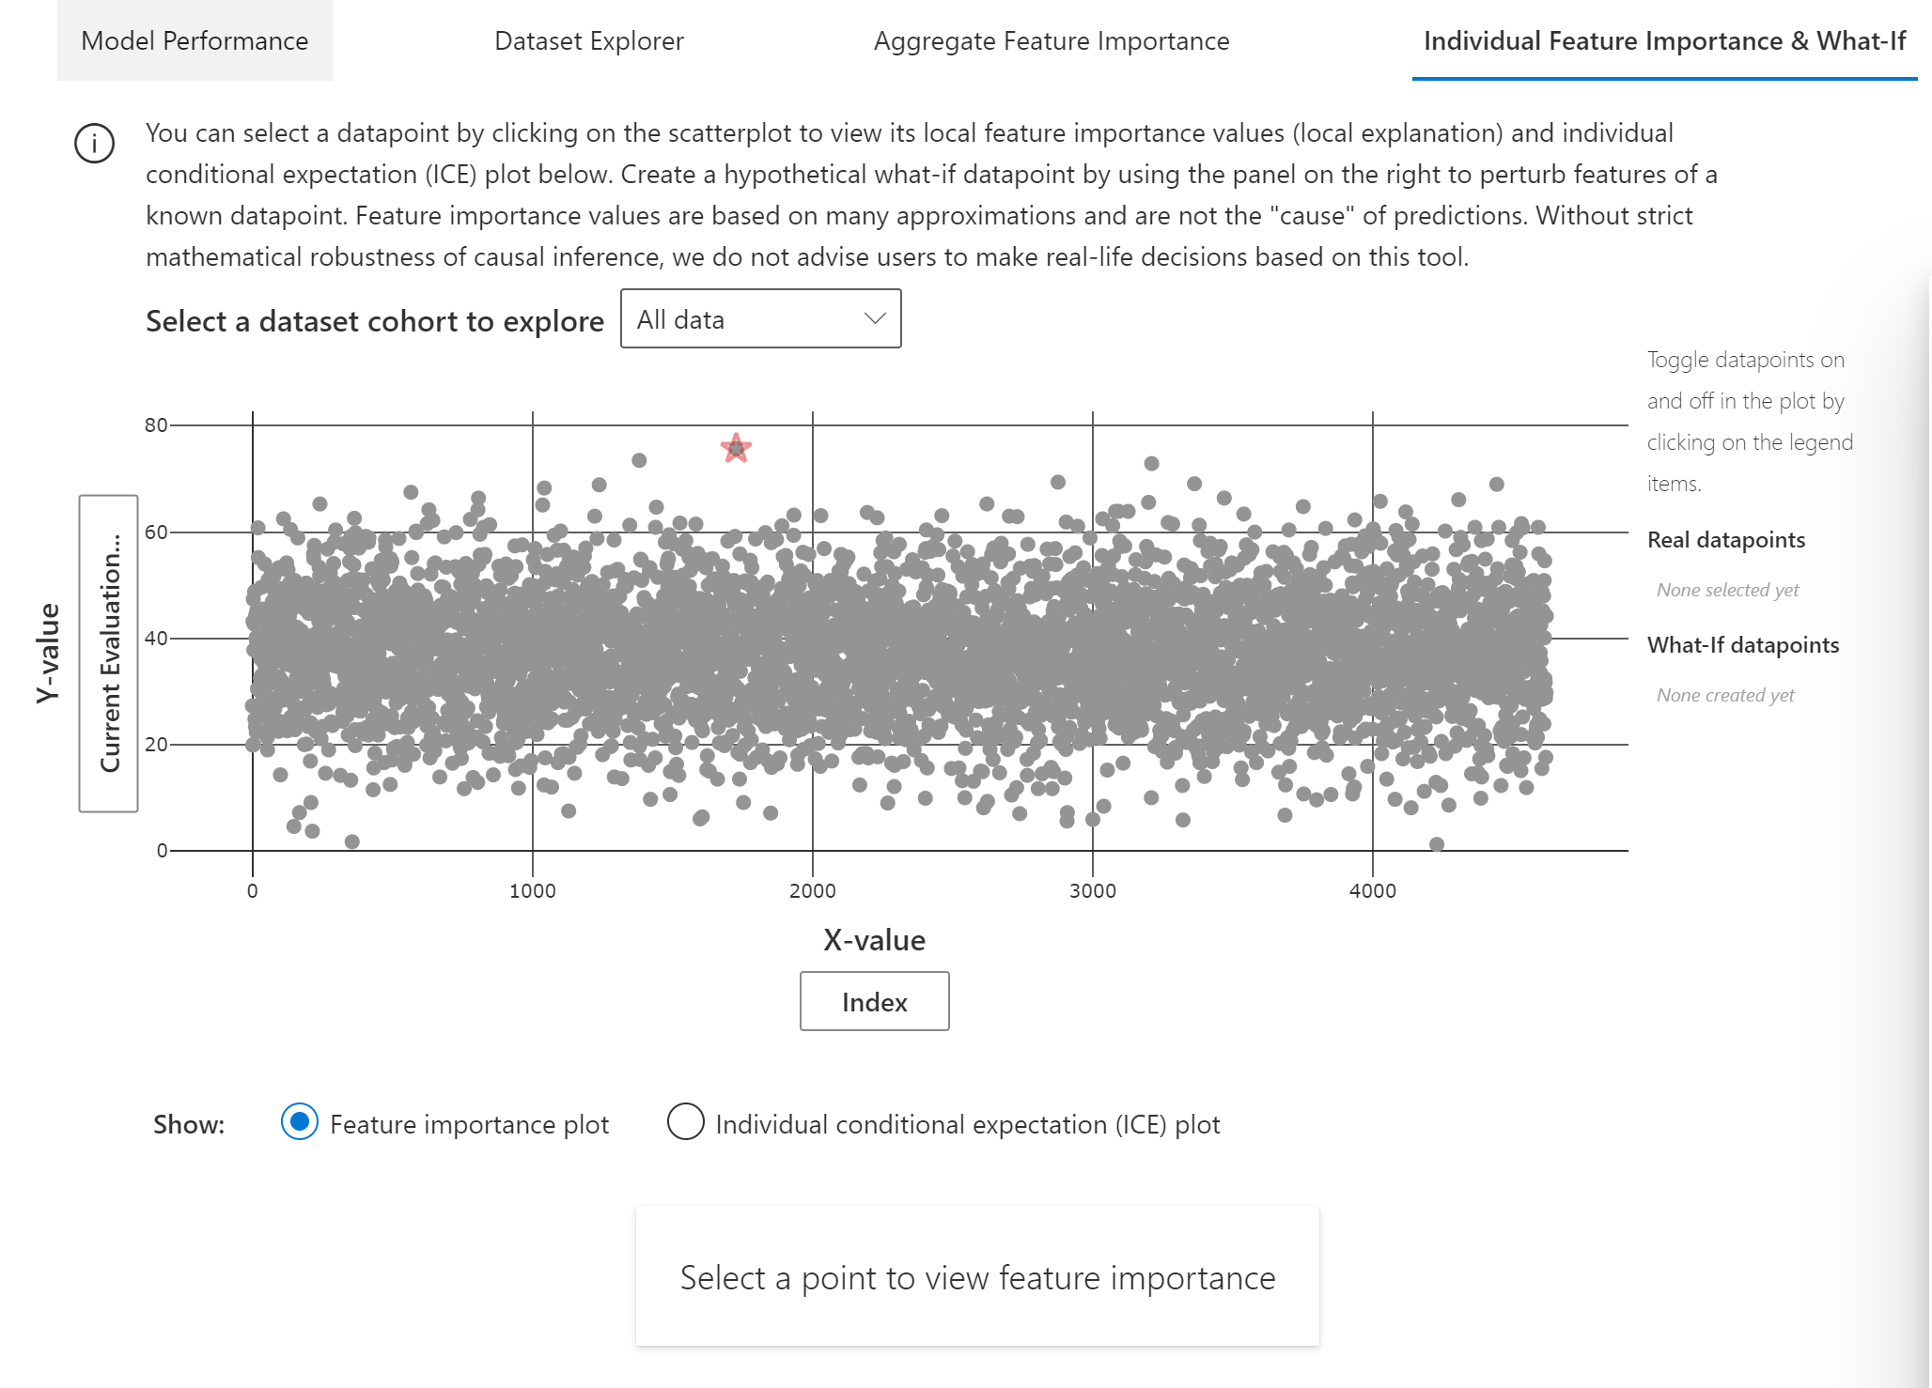
Feature Importance - Individual

Slide 18
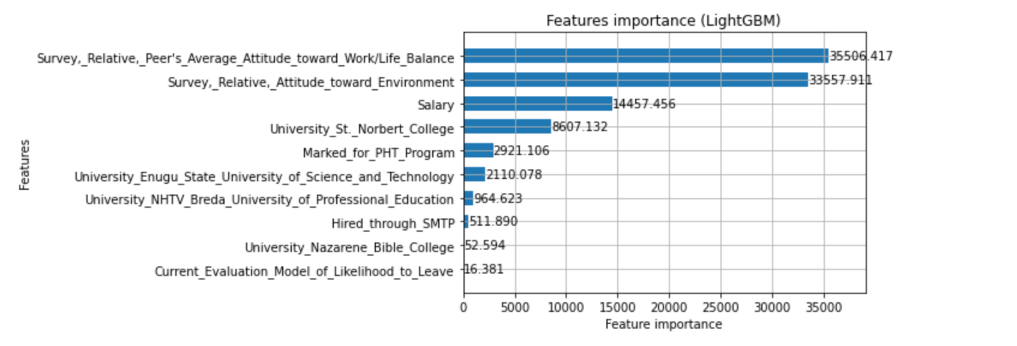
LightGBM features importance

Slide 19
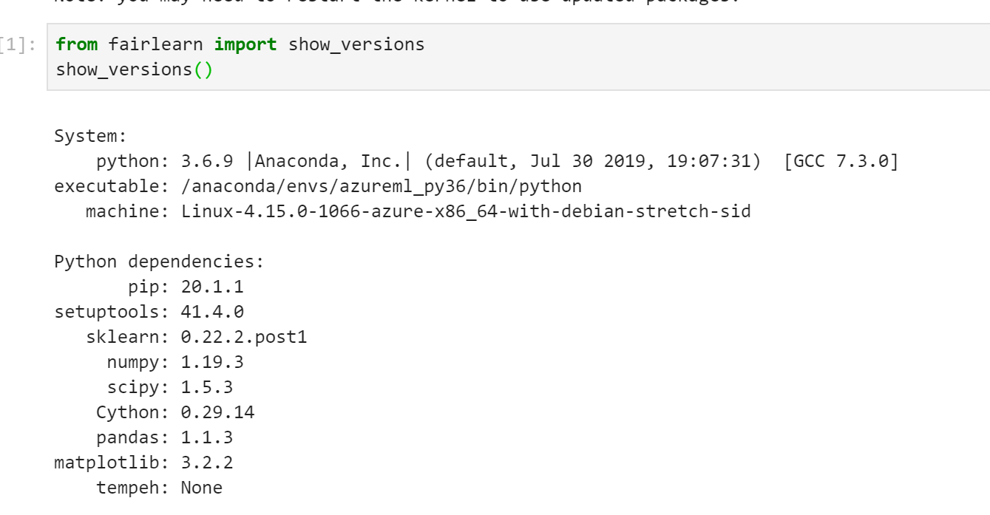
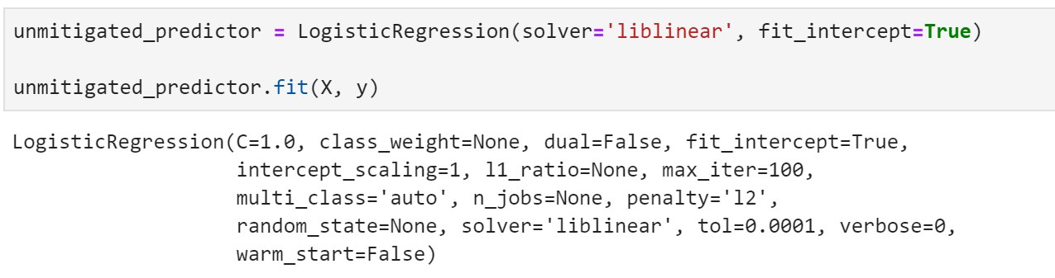
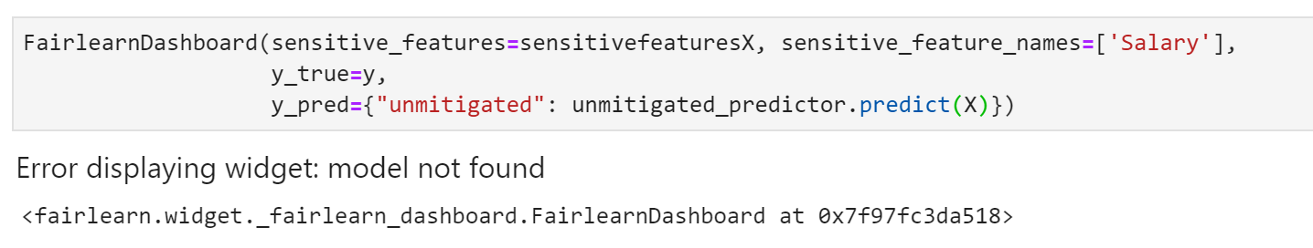
Fairness using Fair Learn

